Slide 1
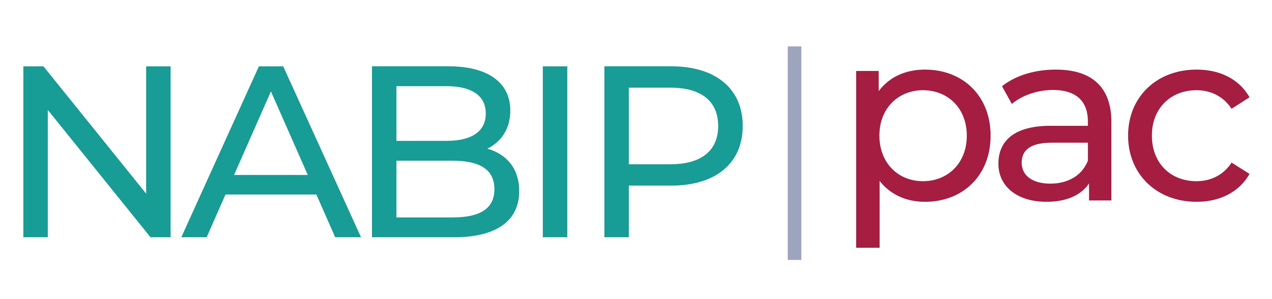
NABIP PAC Presentation

Slide 2
NABIP PAC Board of Trustees
2023-2024
Chair - Raymond E. Magnuson, JD
Vice Chair – Joshua Haberman
Region I – Open*
Region II – Tom Freridge
Region III – Daryl Carlson
Region IV – Open*
Region V – Terry Singleton
Region VI – Tonya Booth
Region VII – Jennifer Farrell
Region VIII – Jill Pedersen
Immediate Past Chair: Ed Oleksiak
At Large – Lori Crandall
*as of August 2023

Slide 3
Why NABIP PAC? We’re able to…
Engage with legislators from both parties to make sure YOUR voices are heard
Educate legislators on how to provide Americans with accessible and affordable health care
Support legislators who will listen and consider our legislative priorities

Slide 4
So, what is NABIP PAC?
Federal law prohibits ALL corporations, labor unions, or associations from giving money directly to candidates at the federal level.
A Political Action Committee (PAC) is a separate segregated fund (SSF) that allows for political advocacy from the connected organization, in this case NABIP.
  That means, no funds come out of your member dues.
NABIP PAC has two separate accounts that each serve their own purpose:
  Candidate Account
  Administrative Fund
NABIP PAC is a FEDERAL PAC regulated by the Federal Elections Commission
  NABIP PAC does not make contributions to state candidates
NABIP PAC is separate & different from your state PAC.
Who can contribute to these accounts, what are the rules, and what are the contributions used for?

Slide 5
What is the NABIP PAC Candidate Fund &
what are the rules?
What happens with my contribution?
Funds in this account directly support candidates for FEDERAL elections
NABIP PAC is limited to a contribution limit of $10,000 per candidate per federal election cycle
  Example:
    Primary Election: $5,000
    General Election: $5,000
    Total: $10,000
Who is eligible to contribute?
Active dues paying NABIP Members & their spouse
NABIP Staff
Who is NOT eligible to contribute?
General Public
Businesses
Clients, vendors, etc.
How much can I contribute?
$5,000 per individual per year
  This is regulated at the federal level by the FEC

Slide 6
What is the NABIP PAC Administrative Fund
& what are the rules?
What do you do with my contribution?
Money in this account goes directly to the operating costs of NABIP PAC.
Operating costs include:
  NABIP PAC Manager Salary
  Presidential Convention Tickets
  Donor awards
  Bank Fees, etc.
This ensures that the candidate fund is ONLY used for political contributions.
Who can contribute?
Individual NABIP Members
NABIP State & Local Chapters
Businesses
Contribution Limits
Unlike the candidate account, there are no contribution limits on the administrative fund.

Slide 7
Contribution Do’s & Don'ts
DO:
Include the following with each contribution:
  Name
  Address
  Employer
  Occupation
DON’T:
Designate any contribution towards a specific candidate
NEVER discuss the campaign or fundraising with a Member of Congress (MoC) or their staff while they are using government resources.
  This includes:
  While in their DC or district office
  While they are working on a Congressional activity
  While corresponding with the MoC or their official staff while using an email or phone number provided by the MoC’s official office.

Slide 8
NABIP PAC – Strategy
With each election cycle, fresh faces enter the halls of Congress, often unaware of the vital role that agents, brokers, and benefits specialists play in health insurance markets.
NABIP’s Government Affairs strategy is threefold:
  Ensure continued representation at the table during the proposal and discussion of legislation.
  Actively educate new lawmakers about the crucial functions you fulfill in the healthcare industry.
  Allocate support from NABIP PAC to areas where it is most needed, ensuring maximum impact and amplification of our message.
Our efforts to raise awareness and offer insights aim to:
  Foster a better understanding of our industry's significance.
  Highlight the positive impact you bring to the healthcare landscape.

Slide 9
NABIP PAC – Strategy
NABIP PAC extends support to members of both parties who are open to listening and considering our legislative initiatives and priorities.
NABIP PAC serves as an essential component of the Government Affairs toolbox, working in tandem with our grassroots advocacy efforts.
  Together, we emphasize the importance of our legislative agenda and its positive impact on reducing healthcare costs for Congressional members' constituents.
Given the split control of Congress and the prevailing appetite for bipartisan solutions in healthcare, it is crucial now, more than ever, to focus on finding and promoting bipartisan approaches to ensure effective and meaningful legislation becomes law.

Slide 10
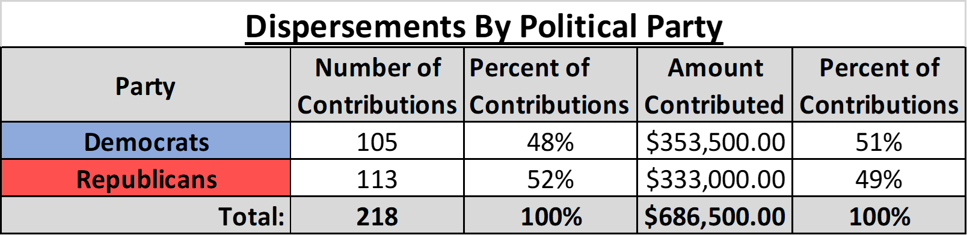
Who did NABIP support in the 2022 election cycle?

Slide 11
Why should YOU contribute?
NABIP PAC provides us with a valuable opportunity to build relationships and educate members of Congress, leading to the introduction of legislation that represents our industry's interests.
Other occupations have successfully established associations and PACs, showcasing the power of a unified voice in shaping policies. By actively participating in our PAC, we can similarly amplify our voice and influence positive changes that benefit our industry and its members.

Slide 12
What has NABIP done for me lately?
Well, beyond advancing positive initiatives, NABIP plays a crucial role in preventing detrimental ideas from becoming law.
  One recent success was our instrumental role in banning surprise medical bills, ensuring patients are no longer burdened with unexpected balances from out-of-network providers during emergencies or situations where had no choice.
  Additionally, NABIP successfully ensured that billions of unused FSA dollars that were rolled over from 2021 to 2022 and 2022 to 2023, providing much-needed flexibility and financial relief for our members.

Slide 13
NABIP PAC Fundraising Goal
2023-2024
Raise: $1,200,000
The larger NABIP PAC's capacity, the greater our reach on your behalf. Our fundraising goal serves to expand our capacity and amplify our impact even further.

Slide 14
NABIP Staff Contact
Caroline Musumarra
Manager of NABIP PAC
202-808-0675
cmusumarra@nabip.org
NABIPPAC.org

